Slide 1
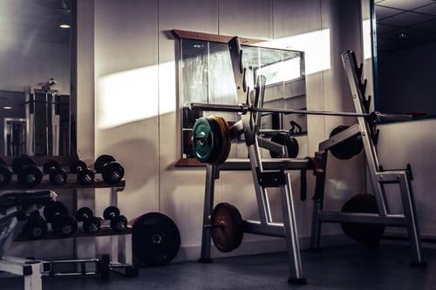
WELCOME

Slide 2
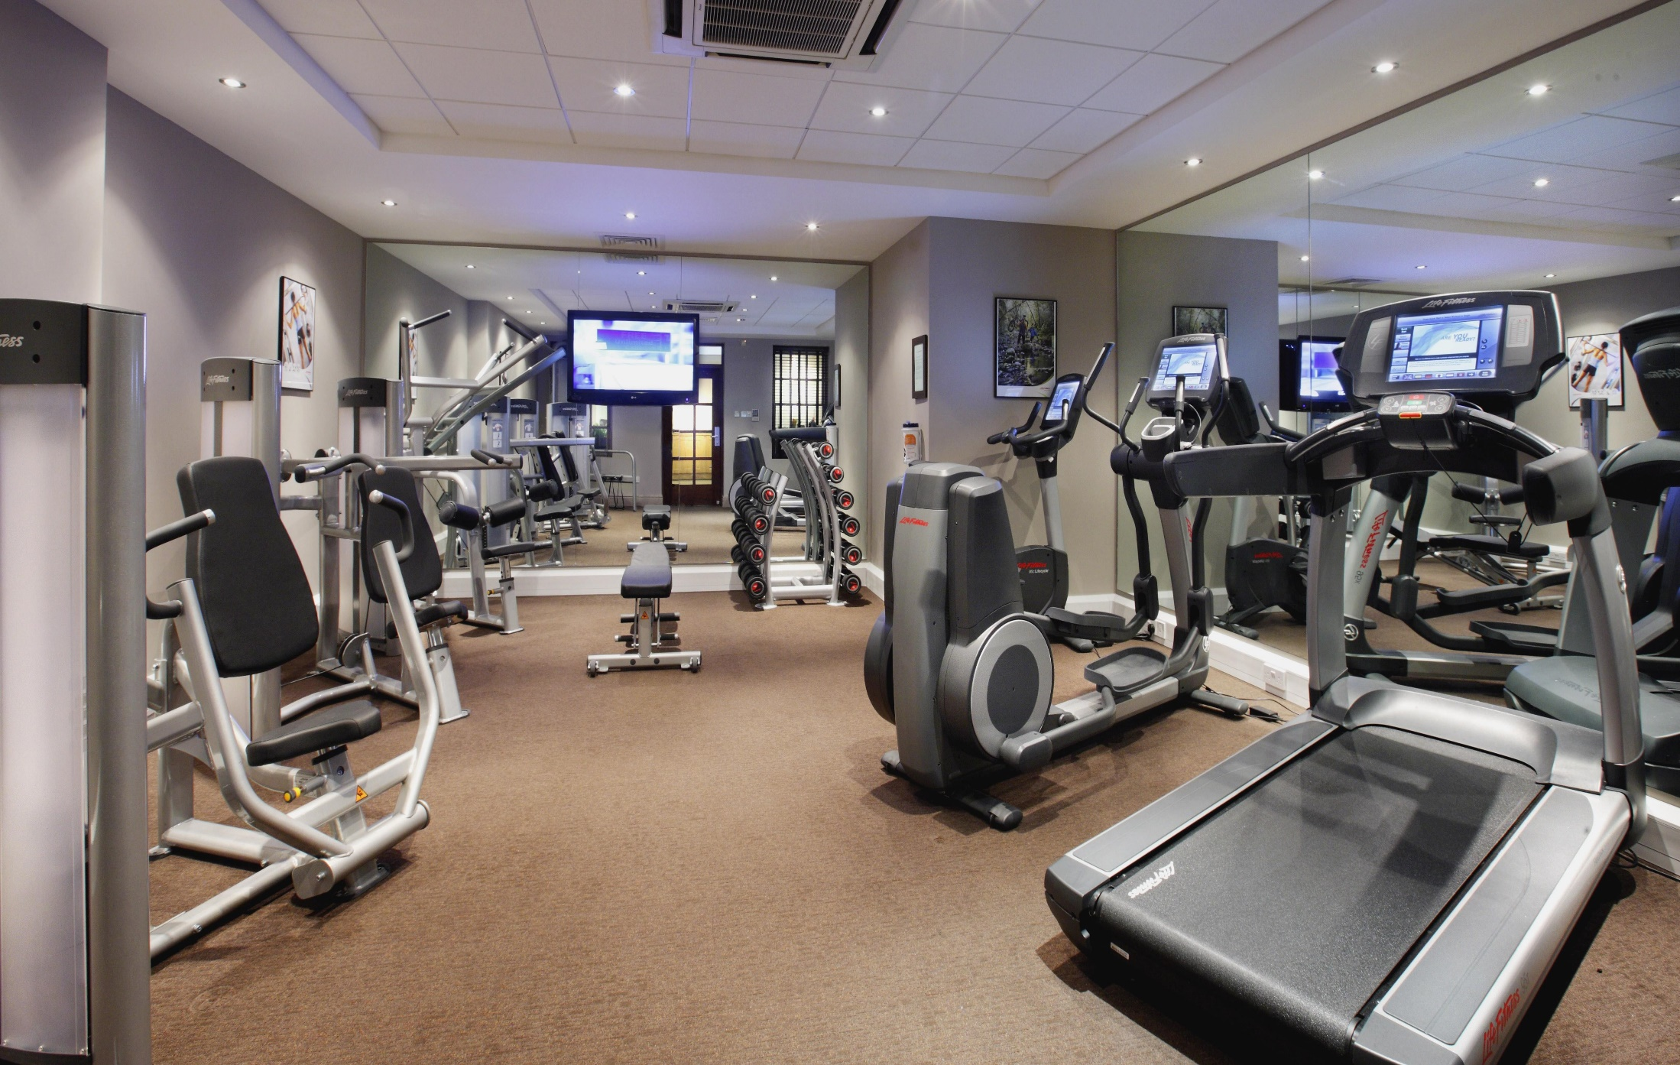
GYM MANAGEMENT SYSTEM

Slide 3
INRODUCTION
We all know health is a wealth. We do not need a fancy car, big apartment, a doctor degree without a health. Being healthy is a first thing we need to keep in mind. Because most of time our attitude depends on how we feel. Being healthy and fit gives us energy to do anything. Physical fitness is very necessary for a healthy and tension free life. Physical fitness includes diet, exercise and sleep. These three basic things have their own importance in each individual's life and everyone should be sensible with regard to these for a healthy life.

Slide 4
ABSTRACT
Any business that does not have a website is missing out on one of the most powerful marketing tools available to them. The main reason that it is important for businesses to have a website is how people are likely to find you. These days most people will go online and research products and companies before they make a purchase. For this reason of dependency on online, we develop a website for a gymnasium in which customer can get all information about the gymnasium and he/she can access or enroll at the gym via online. Usually, the client uses MS Excel or paper, and maintains their records, however it is not possible them to share the data from multiple system in multi user environment, there is lot of duplicate work, and chance of mistake. When the records are changed they need to update each and every excel file. The Smart Gym Management System eliminates most of the limitations of the existing software. Increasing efficiency and effectiveness, automation, accuracy, user-friendly interface, information availability, communication capacity, maintenance, cost reduction makes our system smarter than the existing system.

Slide 5
OBJECTIVES
The main objective of the projective is to develop software that facilities for the data storage, data maintenance and its retrieval for the gym in an igneous way.
To store the record of the customers, the staff that has the privileges to access, modify and delete any record and finally the service, gym provides to its customers.
Also only staff has the privilege to access any database and make the required changes, if necessary.
To develop easy-to-use software which handles the customer-staff relationship in an effective manner.
To develop a user-friendly system that requires minimal user training. Most of the features and function are similar to those on any windows platform.
Secured data storage for authority end.
Secure the user ends data by providing each user’s own personal credentials.
To provide better graphical user interface.
Computerization can be helpful as means of saving time and money.

Slide 6
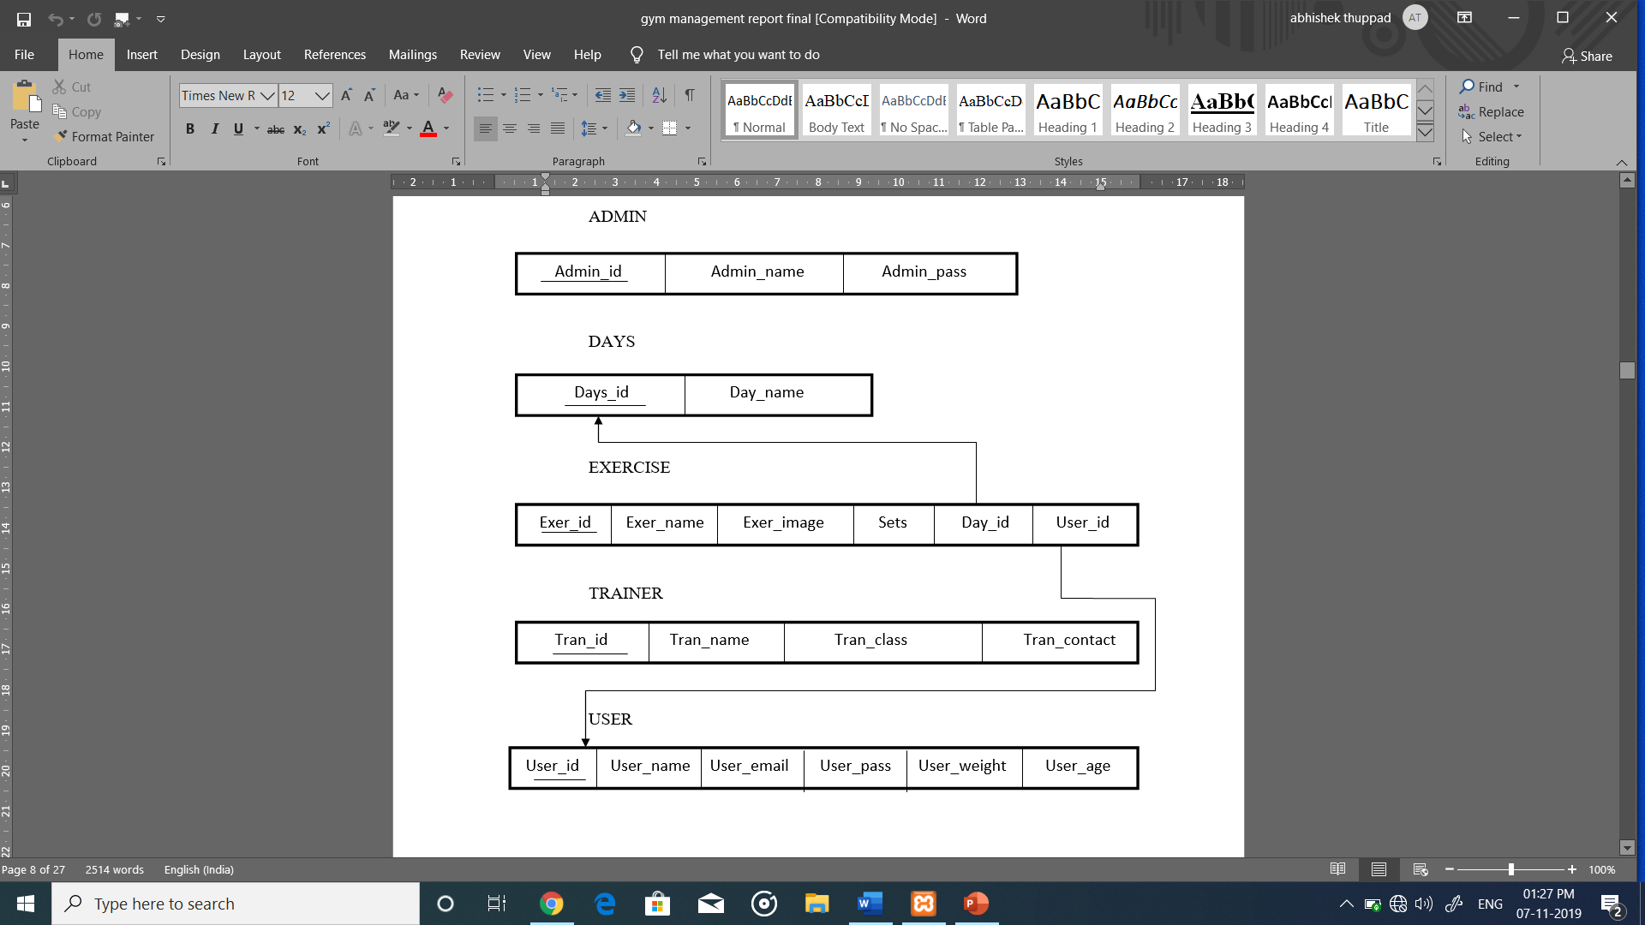
Schema DIAGRAM

Slide 7
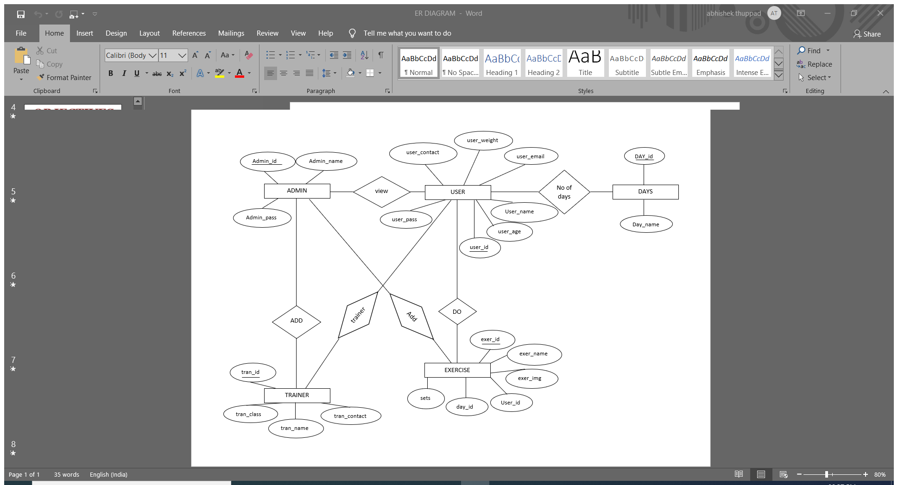
E-R DIAGRAM

Slide 8
SYSTEM REQUIREMENTS SPECIFICATION
HARDWARE REQUIREMENTS
Processor :- Celeron or above
Windows:- Windows 7 or higher
RAM:-2 GB
Hard disk:-100 GB(Recomended)
SOFTWARE REQUIREMENTS:
Operating System:- Windows,Lunix,Mac os
Programming Language:- PHP
User Interface:- HTML,CSS
Database:- MYSQL
Server Developmnet :- XAMPP
Browser:- Google chrome

Slide 9

SNAPSHOTS

Slide 10
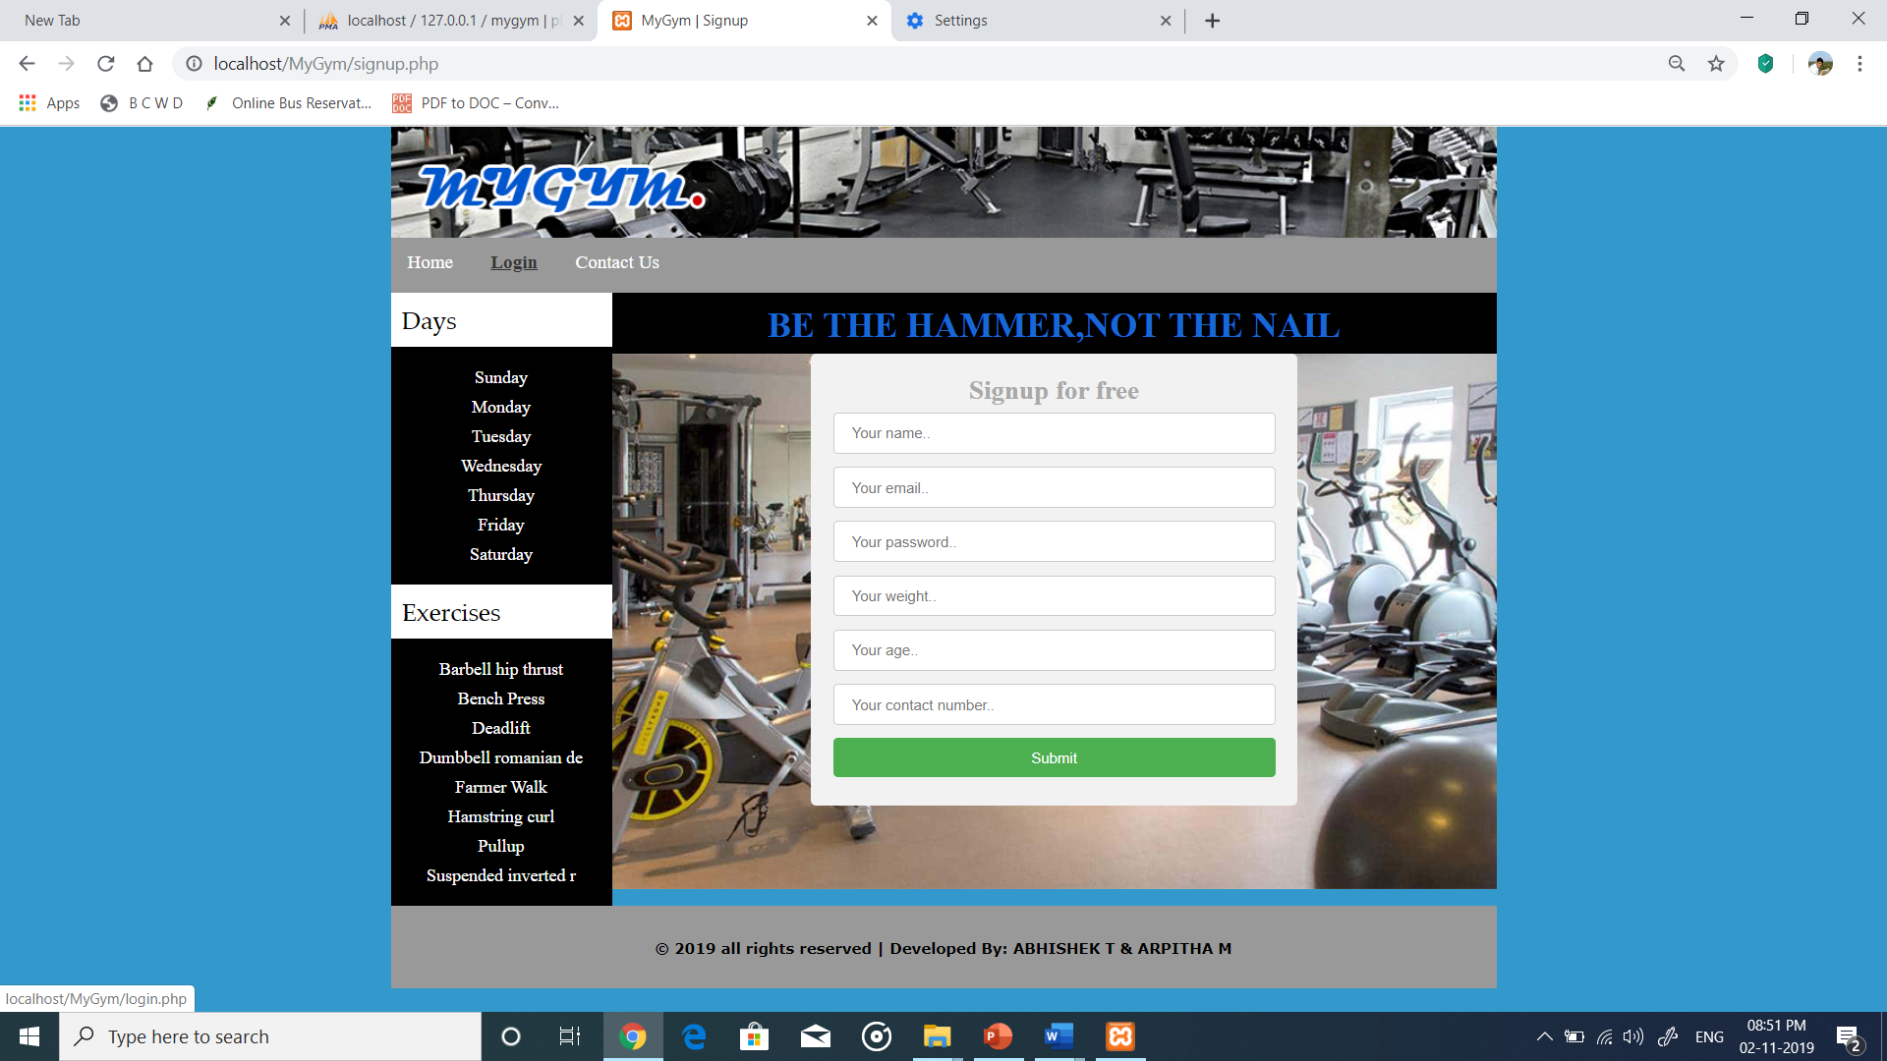
Sign up

Slide 11
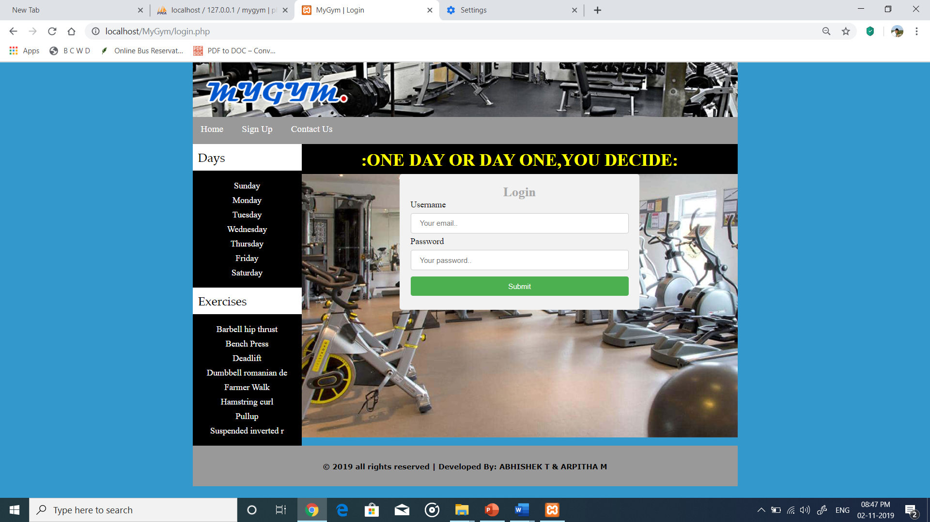
Login page

Slide 12
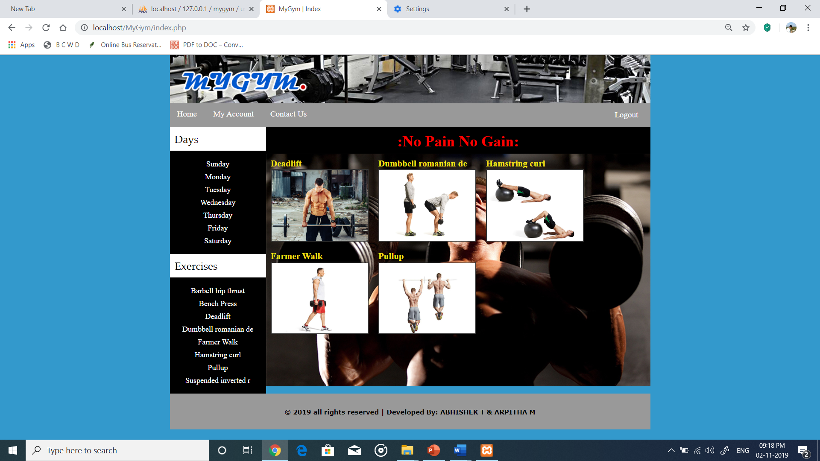
Home page

Slide 13
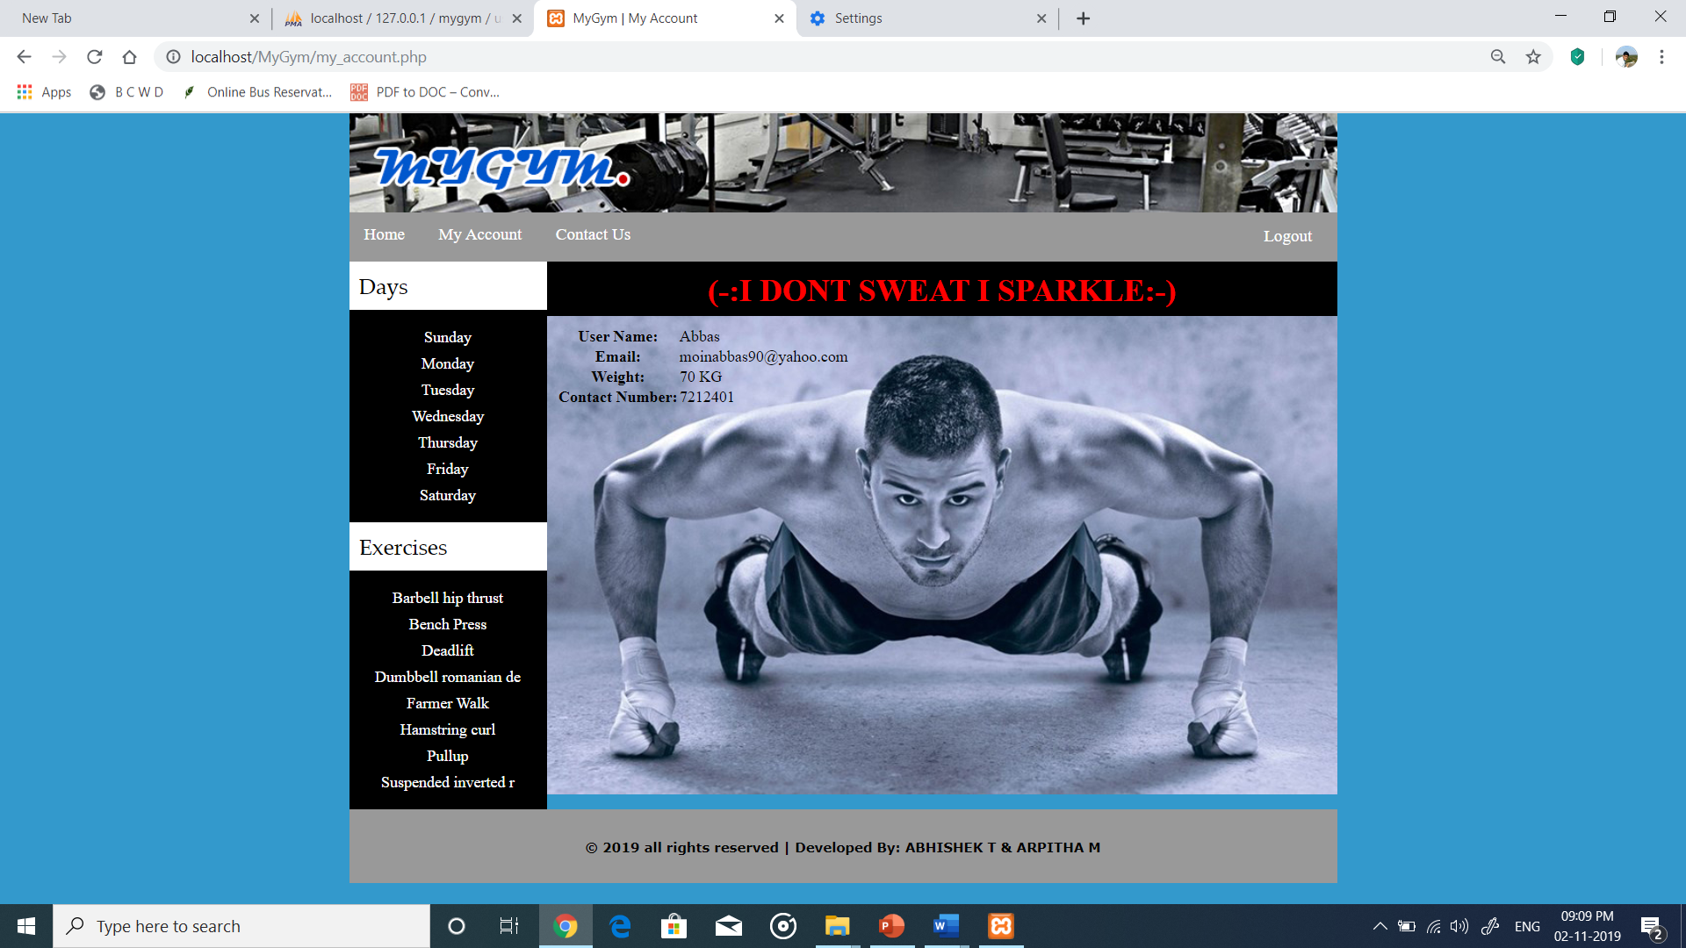
Account details

Slide 14
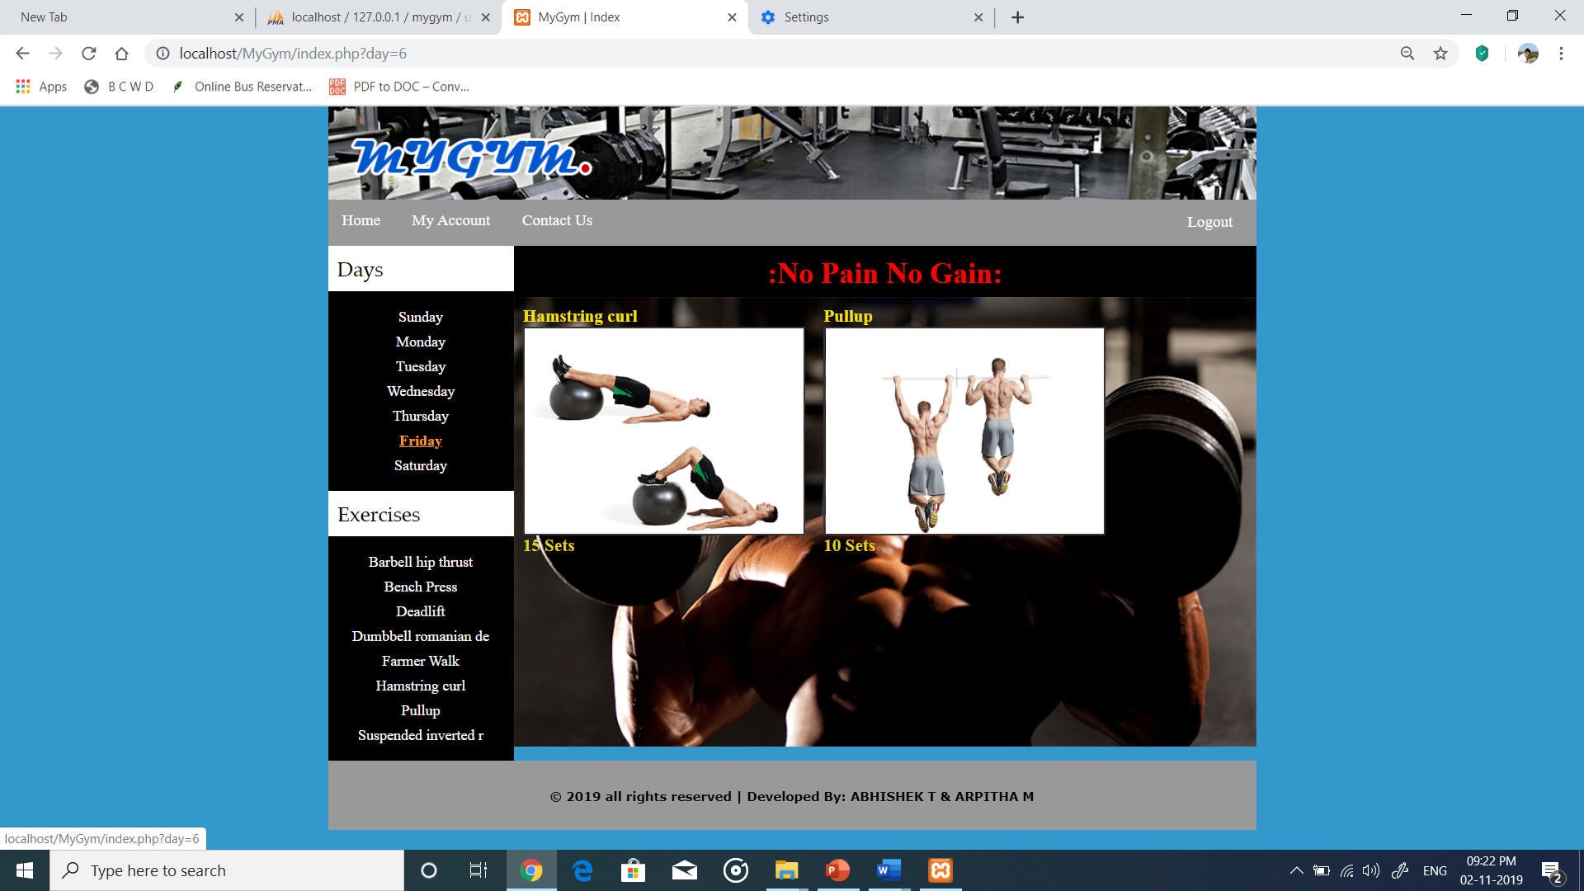
Daily Exercise

Slide 15
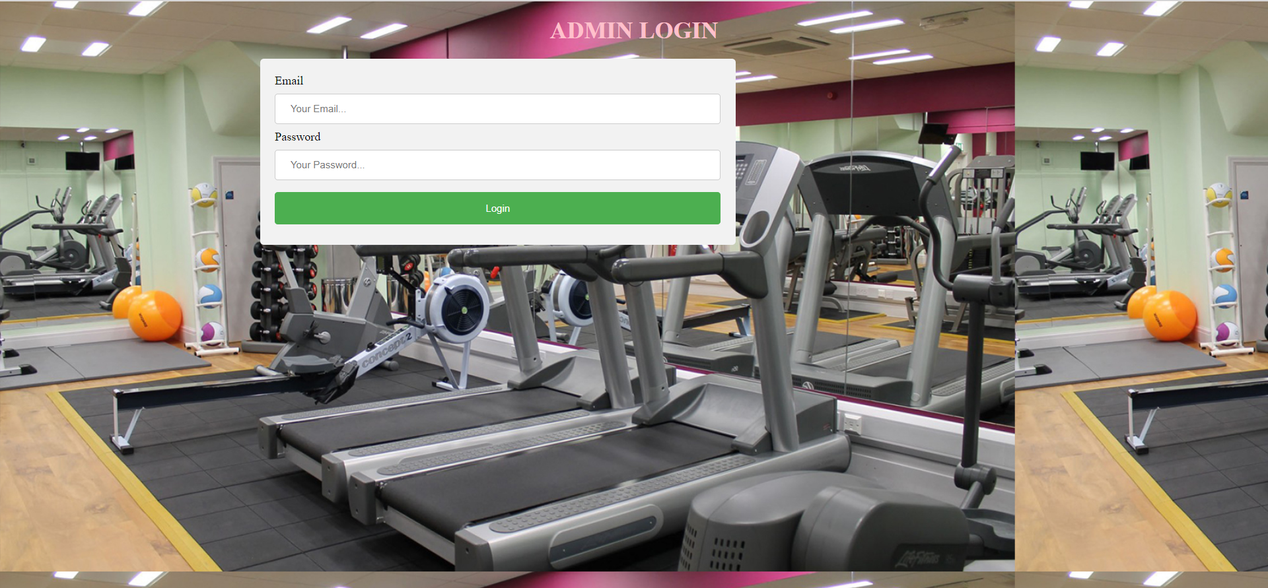
Admin login page

Slide 16
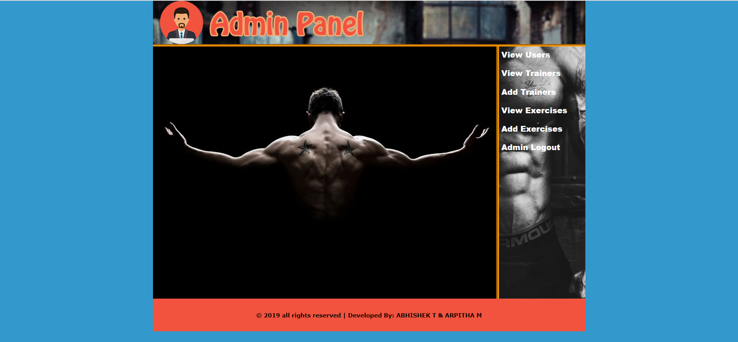
Admin home page

Slide 17
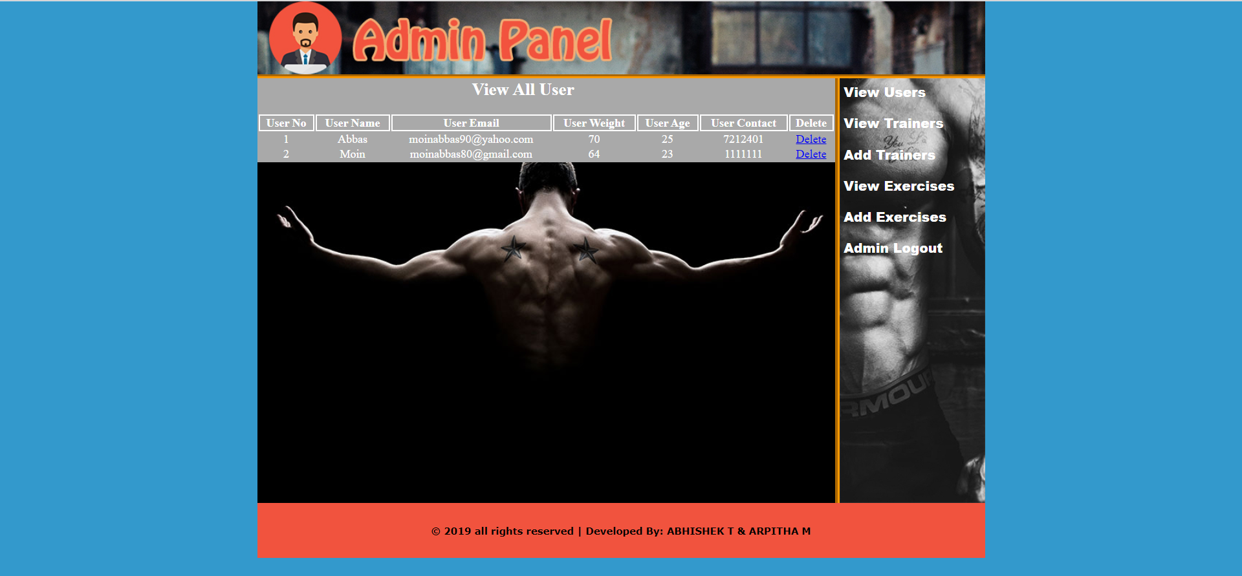
View All Users Page

Slide 18
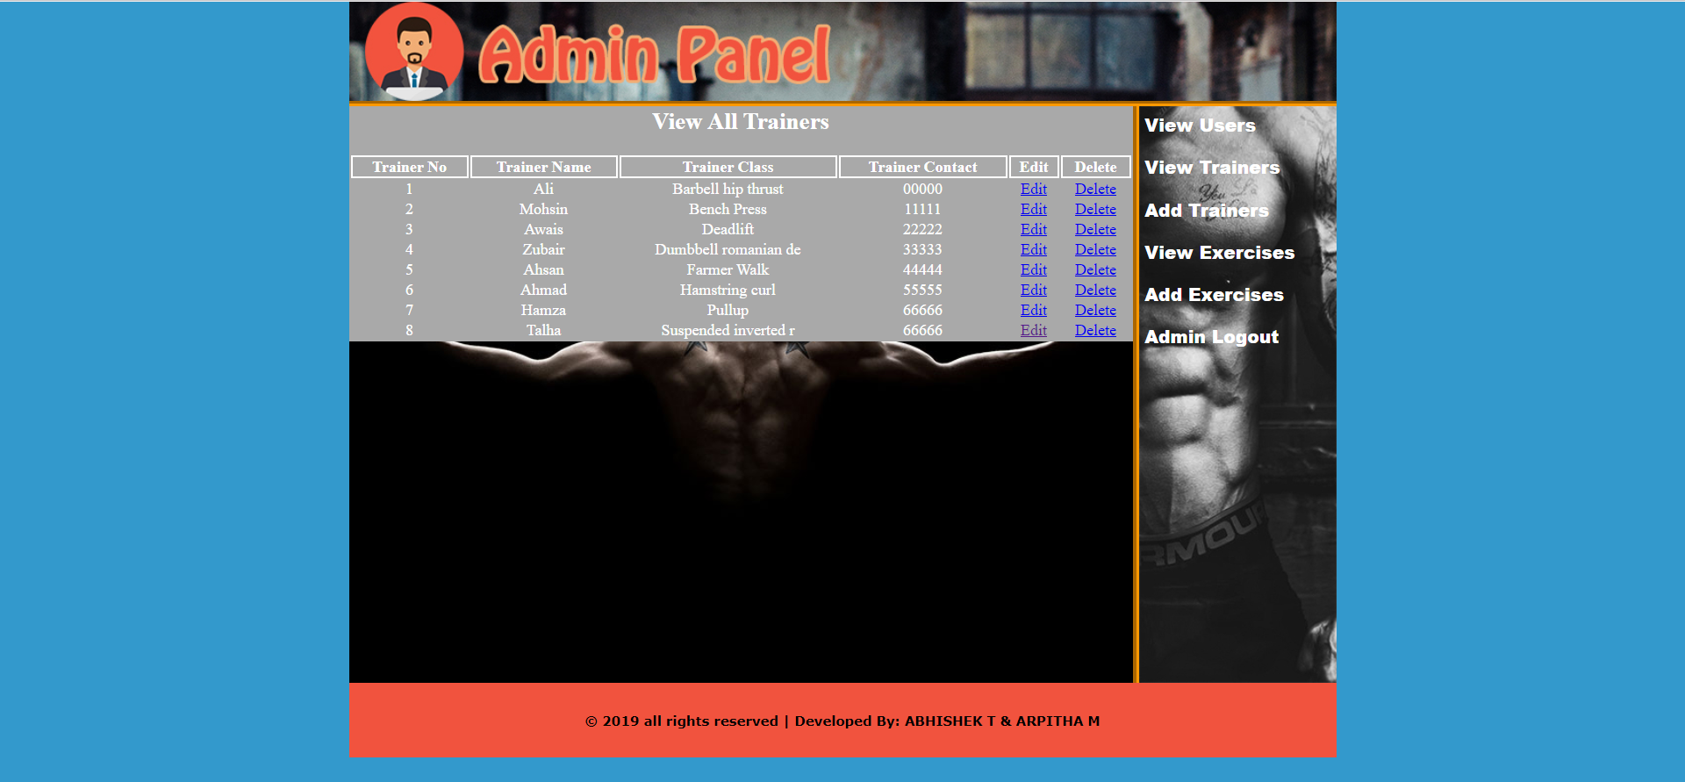
View All Trainers

Slide 19
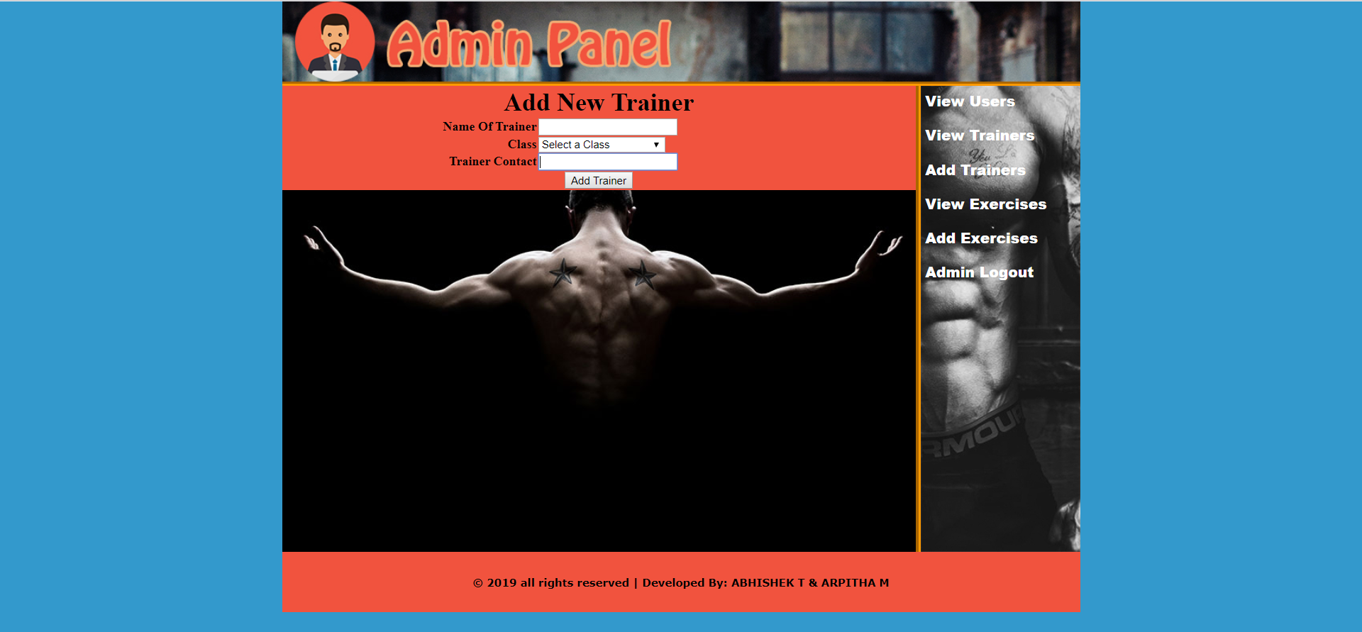
Add Trainers

Slide 20
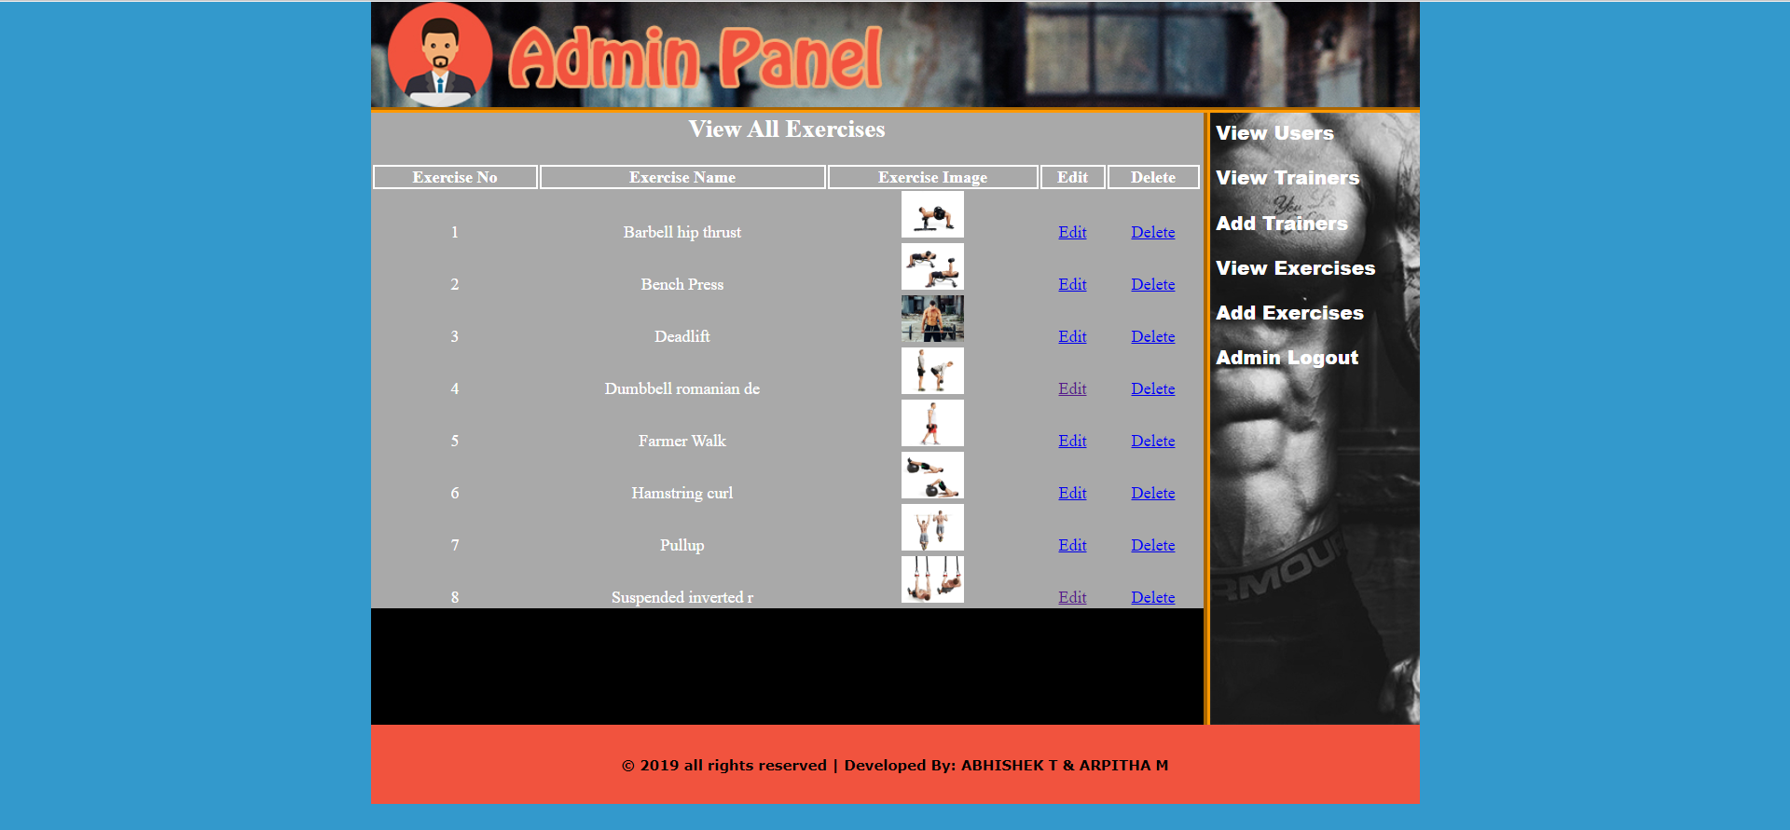
View All Exercise

Slide 21
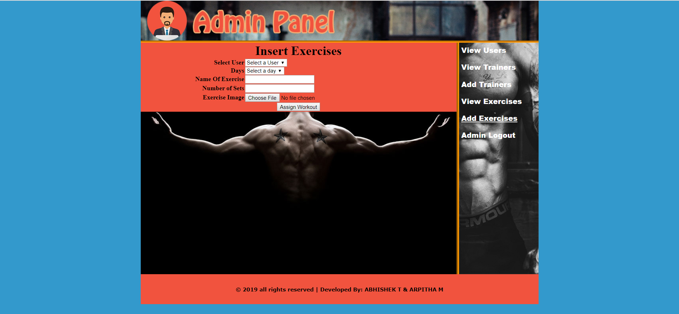
Add Exercise

Slide 22
OUTCOMES
Security of data.
Ensure data accuracy’s.
Proper control of the higher officials.
Minimize manual data entry.
Minimum time needed for the various processing.
Greater efficiency.
Better service.
User friendliness and interactive.
Minimum time required.
Reduces the cost of maintenance.

Slide 23
CONCLUSION
The “GYM MANAGEMENT SYSTEM” is successfully designed and developed to fulfilling the necessary requirements, as identified in the requirements analysis phase, such as the system is very much user friendly, form level validation and field level validation are performing very efficiently. The old manual system was suffering from a series of drawbacks. The present project has been developed to meet the aspirations indicated in the modern age.

Slide 24
THANK YOU

